Slide 1

Project Glasswing
Team Mockingbird: Austin Malmin
ShanHong “Kyle” Mo
Conrad Murphy
Charles Saluski
Notes:
Hello, we are team mockingbird working on project glasswing.

Slide 2



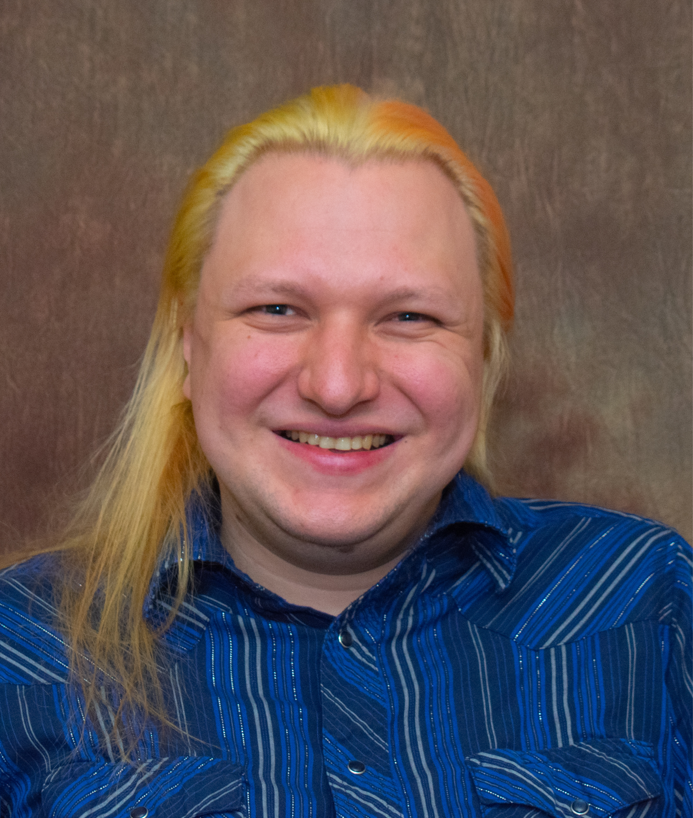
Meet The Team
Austin:
Team Lead / Customer Communicator
Kyle:
Architect / Recorder
Conrad:
Release Manager / Hardware Lead
Charles: Navigation Lead / Coder
Sponsor: Alexander Shenkin
Mentor: Daniel Kramer
Faculty Member: Michael Leverington
Notes:
Our team consists of four members including myself as the team lead and main customer communicator, Kyle, who is responsible for the overall architect and recorder, Conrad who is our release manager and hardware lead. Our newest member is Charles who is taking charge of the navigation stack and general coding help. Our team is mentored by Daniel Kramer, a graduate astroinformatics student, and Michael Leverington, a faculty member here at Northern Arizona University.

Slide 3
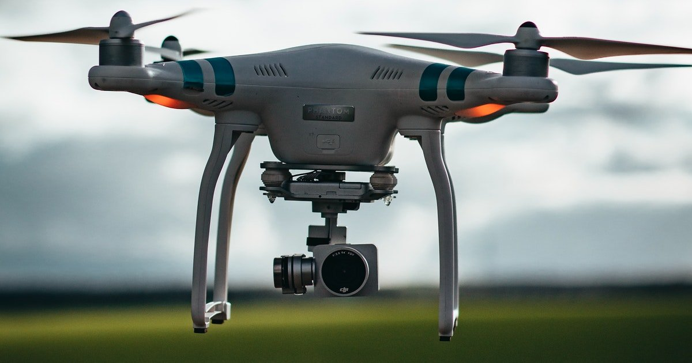
Autonomous Navigation System for Drones
Search and Rescue Missions
Transportation and Delivery
Film and Photography
Agricultural Crop Spraying
Complete Mapping of Ecosystems and Their Microenvironment
(Source: Pexels)
Notes:
We have been tasked with the construction of an autonomous drone navigation system. This system has widespread applications from simple tasks of photography and agricultural purposes to more complex tasks of transportation and delivery being implemented by Amazon and more dangerous tasks of search and rescue missions and military operations these. Our application will be to create complete maps of forest ecosystems and their environment.

Slide 4
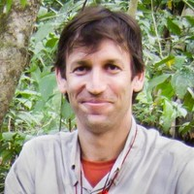
Our Sponsor - Dr. Alexander Shenkin
Background in Computer Science, Electrical Engineering, Physics and Forestry
Studies forest structure and its impact
Uses maps of real-world forest for testing in game engine
(Source: Dr.Shenkin)

Slide 5
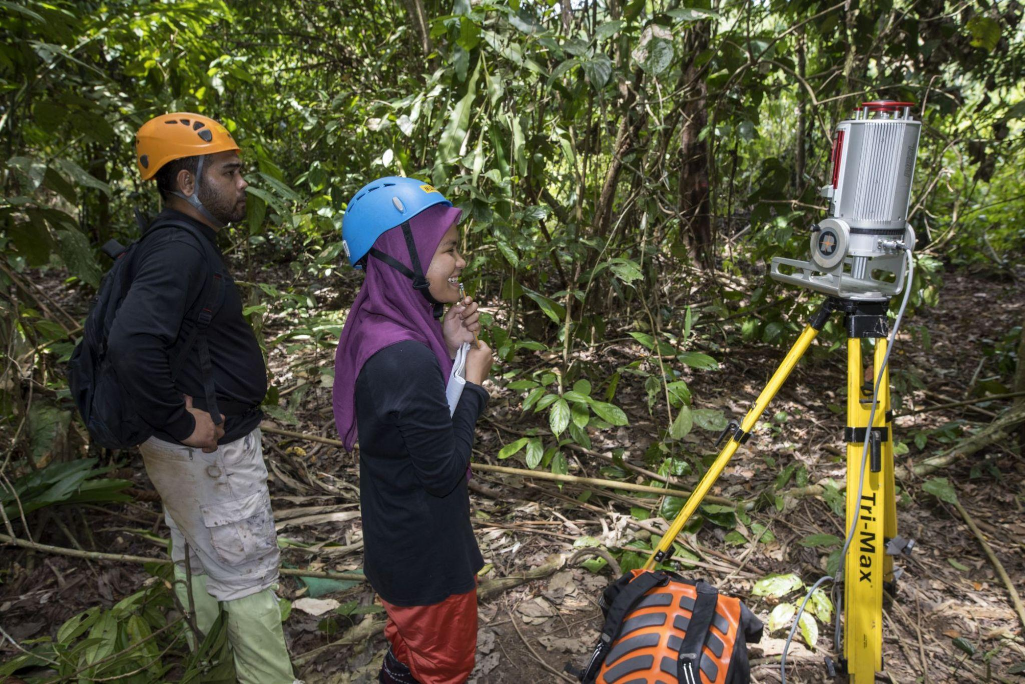
The Problem
Large, heavy LiDAR
Limited range + obstacles
Ground-level detection only
Two members of Dr. Shenkin’s research crew scanning the forest using a 360 degree LiDAR on a tripod.
(Source: Dr. Shenkin)
Notes:
Talk about what is a lidar and how it generally works

Slide 6
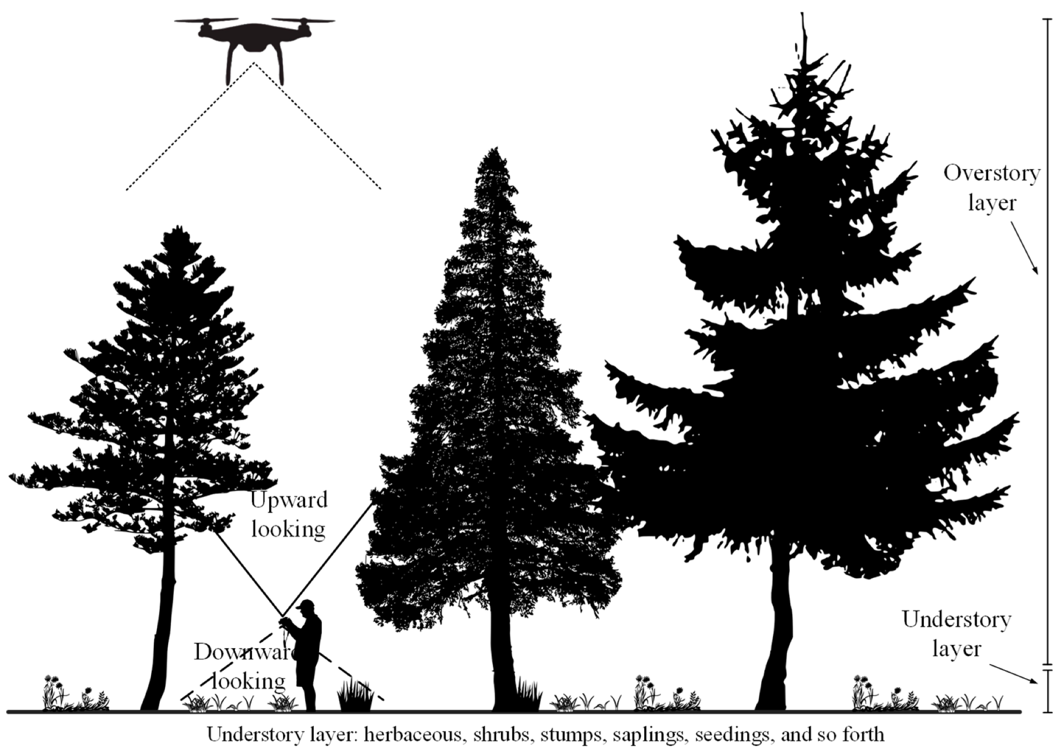
Our Solution
Autonomous navigation system intended for a drone
Detect and avoid objects, and plan a future path
A UI which displays how the drone should move
(Source: MDPI)
Notes:
Our solution is to use an automated drone to perform this job instead. This drone would use LIDAR sensors and depth cameras to detect any obstacles in the forest environment, and maneuver around them accordingly by commanding the drone to move in certain directions for certain periods of time. Over time, the sensors would build a map of the environment and use it to create routes through the understory. This map would be procedurally written into memory for future use. Note that our project will not be immediately implemented onto a drone. Our navigation system simply needs to provide readable output to the user which indicates that the system can avoid obstacles as required. As we finish the software component of Project Glasswing, we are communicating with an EE Capstone team who will work on the hardware side of the project, including a physical drone and a 3D LiDAR.

Slide 7
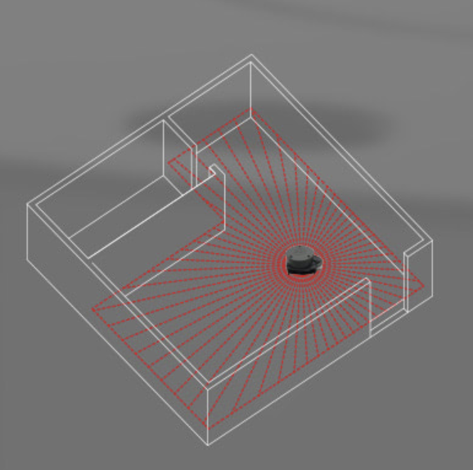
Requirements Overview
Minimum requirements:
Automatic detection of objects
Able to move towards a destination
Tell the user which direction it is moving
Stretch goals:
Show a display screen of the planned path that it will take
Store and display/print the area visited
Visit as much of the designated space as possible
(Source: Amazon)
Notes:
In our requirements acquisition, we determined some basic-level requirements for safely navigating the forest environment. At minimum, our system must automatically detect objects of size 1cm or larger that are in the way, then provide an output direction to move in order to avoid it. The system should also have goal-oriented movement towards a desired direction or point. Upon finishing these goals, we pursued additional stretch goals for the projects, such as to save a map to permanent storage, to display a planned path for the drone to take, and to visit as much unvisited space as possible.

Slide 8
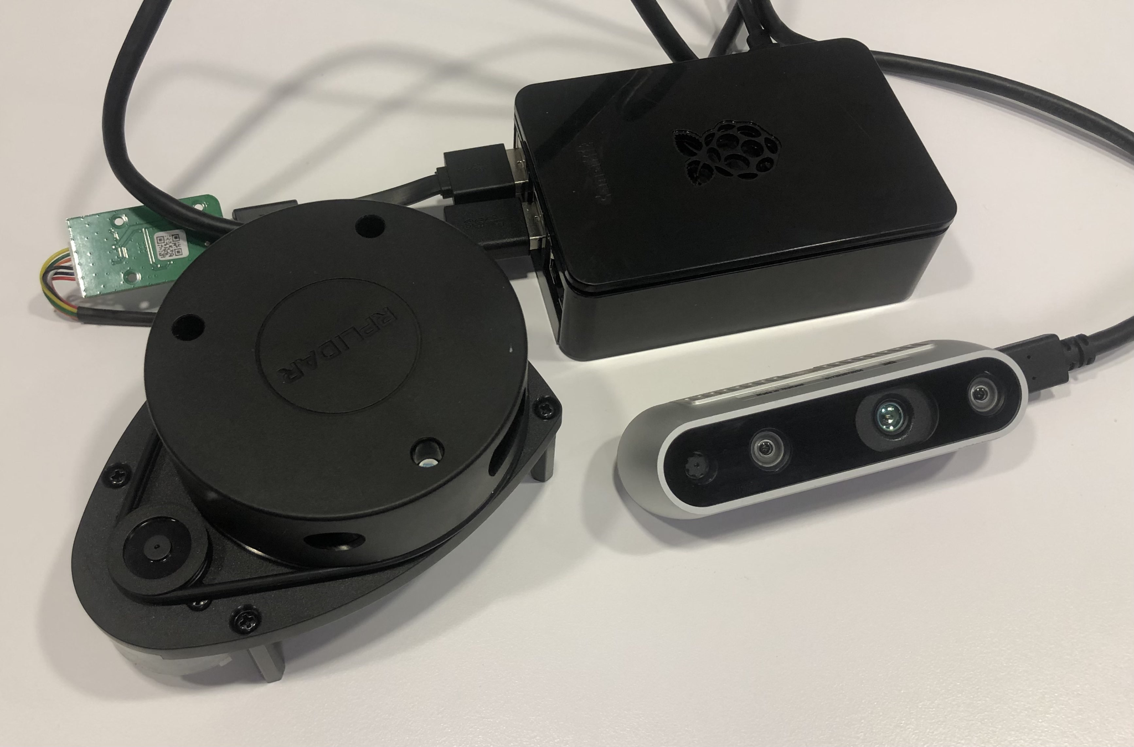
Implementation Hardware and Software
Hardware:
Raspberry Pi
LiDAR sensor
Depth camera
Power source
Software:
Robot Operating System (ROS)
ROS vision libraries
Simultaneous Localization and Mapping (SLAM) libraries
Our own system

Slide 9
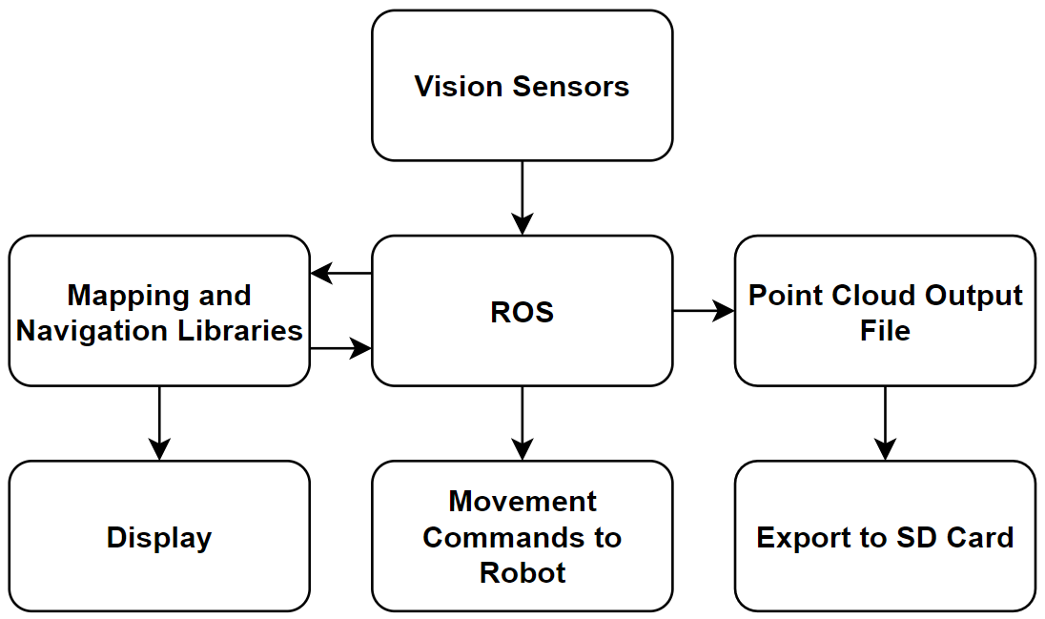
Implementation Architecture
Notes:
ROS interfaces to the mapping and navigation; mapping and navigation publishes to a display; ROS writes to file

Slide 10
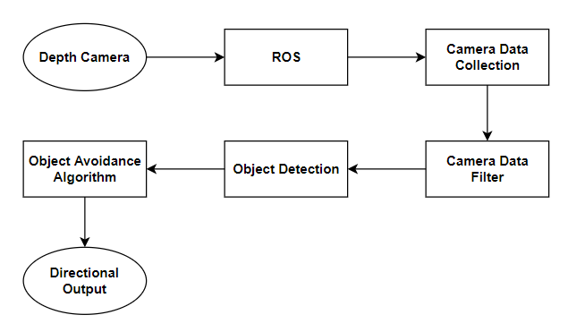
Implementation Details: Object Avoidance

Slide 11
SLAM Demo

Slide 12
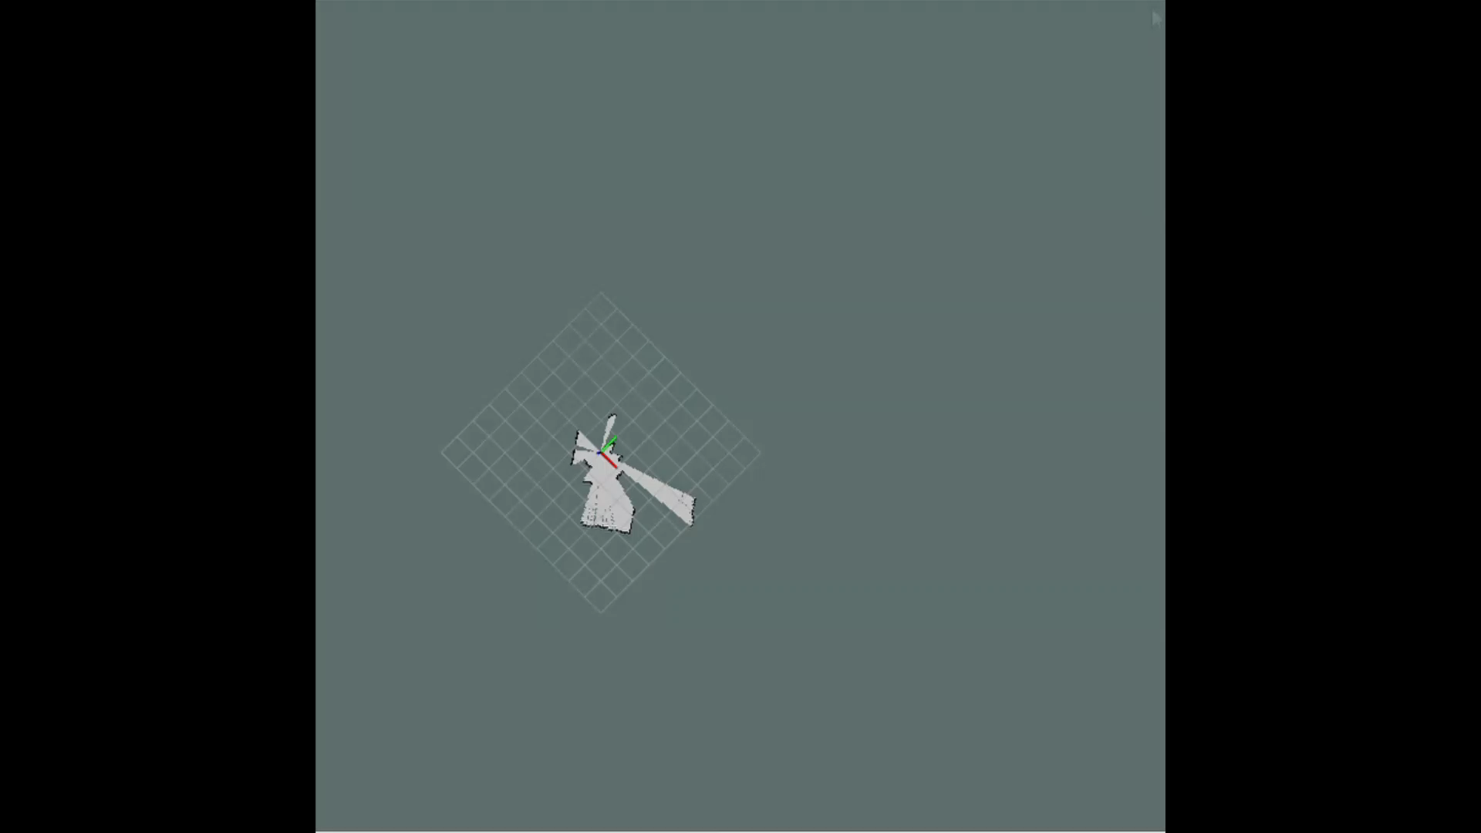

Slide 13
Navigation Demo

Slide 14
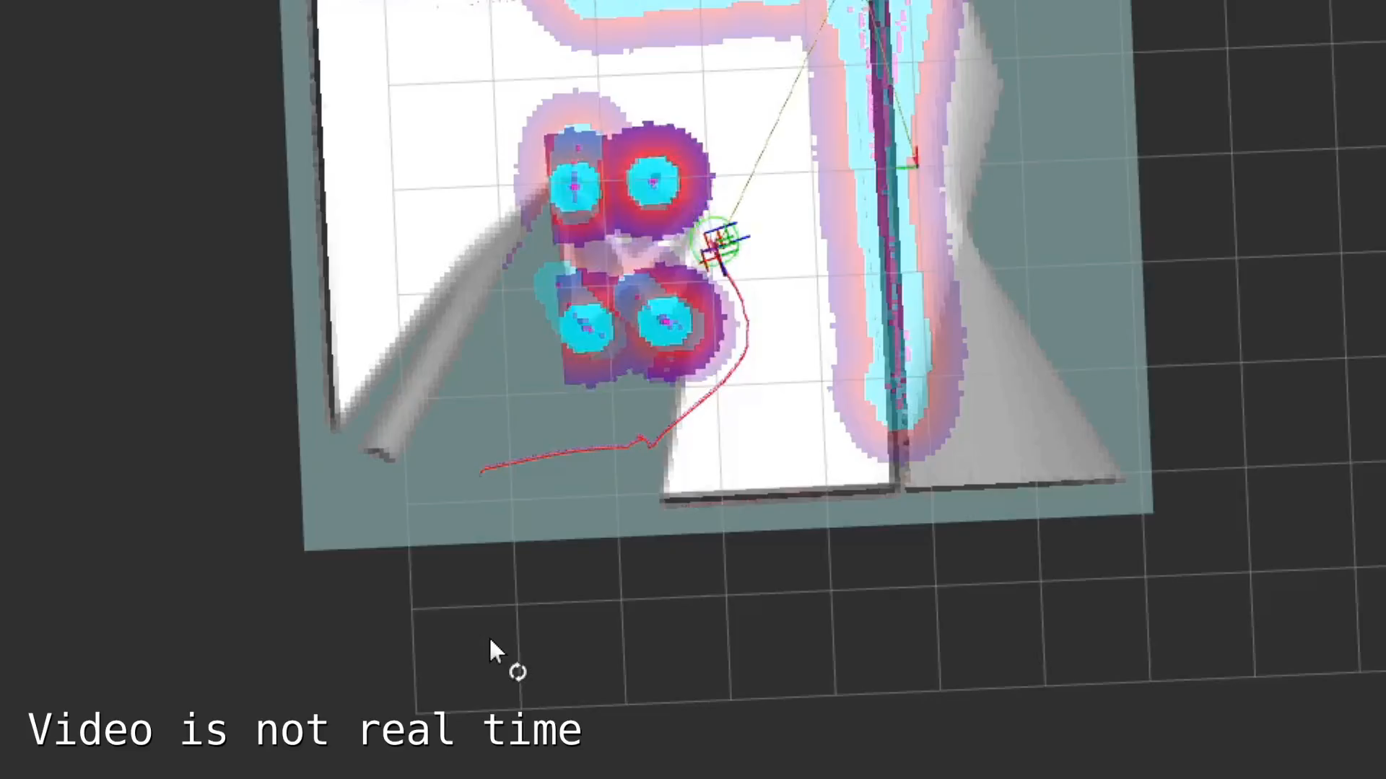

Slide 15

Challenges
Integration of both hardware and software
Development without a drone
Compatibility
  ROS and ROS 2 have different compatible software
Hardware issues
  Fake SD card
  USB cord capabilities
  Shipping delays
(Source: Entrepreneur)
Notes:
ROS 2 is a

Slide 16

Solutions
Test early and often
Try different options
Ask the experts
Document data
(Source: Freepik)

Slide 17

Testing Plan
Unit Testing
  Hardware, ROS, navigation libraries
Integration Testing
  Full system
  Simulated drone
Usability Testing
  Installation guide, automation scripts
(Source: Flaticon)

Slide 18
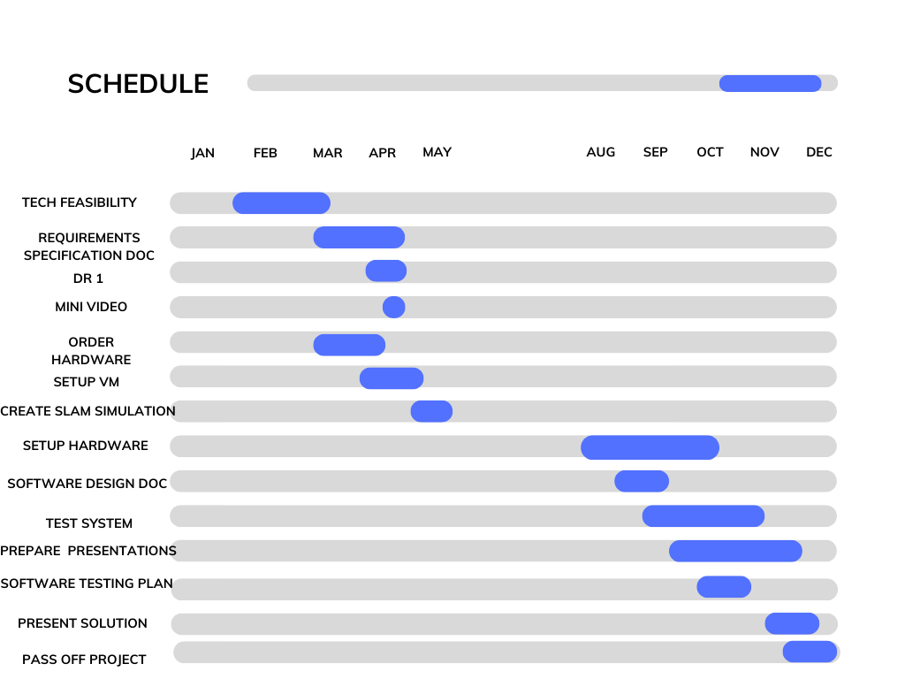
Schedule
Notes:
This is our team’s final section of our schedule. Looking at the schedule, we are at the last leg of the project as we finished building the system as well as testing it and making small adjustments to the sponsors preferences. Other than that, we are left with finalizing the papers and preparing for presentations.

Slide 19
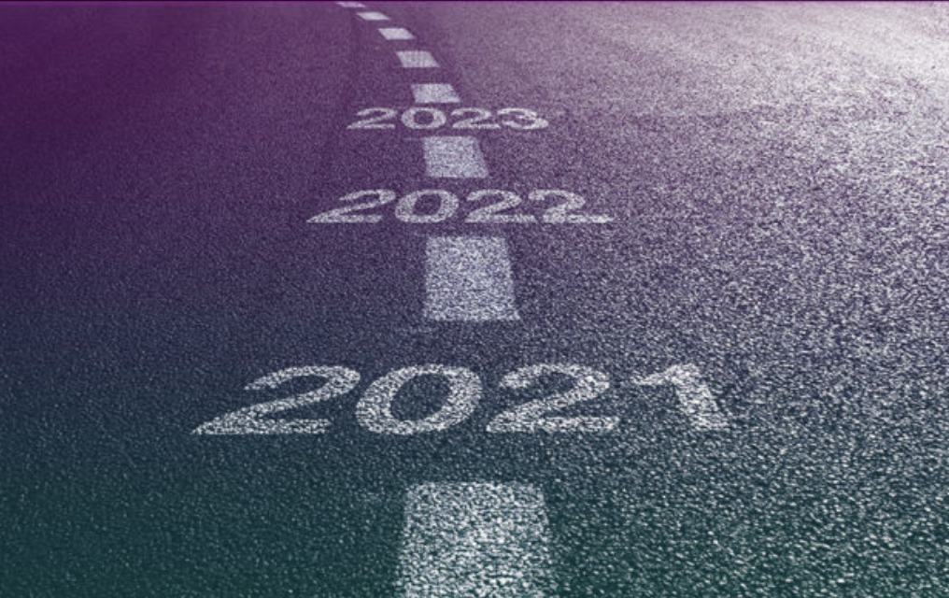
Future Work
Expand modules from 2D to 3D
Find compatible drone to mount
Mobile power source
Test in realistic environment
(Source: Graphus)

Slide 20

We will enable…
Lasting benefits in studying ecology and micro-environments of forests
A powerful, expandable, and customizable module for future work to build on
Removing humans from dangerous tasks
(Source: Pexels)
Notes:
With our system, we hope that it will have lasting benefits in the field of research. This system has been built in a way that is customizable, allowing this project to be passed on for others to continue to build on top of what already exists, which we are already in the process of passing it on to an EE team. With this system, we hope that it will remove human from dangerous tasks by using drones to go to places that is difficult or dangerous for human to reach

Slide 21

In Conclusion…
Goal oriented navigation system with obstacle avoidance
LiDAR-based mapping system utilizing SLAM
Transitioning to EE team
Great benefits for research in this field
tinyurl.com/mockingbird2022
Notes:
To summarize, we have built a goal oriented drone navigation and mapping system with the main purpose of serving forestry related work. As of now, we are ahead of schedule as we are done with the system we are compiling. And with our system, we want to have great benefits for research in this field as well as other fields that requires a navigation system.

